Slide 1
Direct Memory Access
And
DMA-Controlled I/O
Prof. Virender Kr. Ranga
Department of Computer Engineering
National Institute of Technology
Kurukshetra

Slide 2
Agenda
  Describe a DMA transfer.
  Explain the operation of direct memory access control signals.
  Explain the function of the 8237 DMA controller when used for DMA transfers.
  Programming the 8237 to accomplish DMA transfer.

Slide 3
In the applications, where the CPU is to transfer bulk data, it may be waste of time to transfer the data from source to destination using
Program Controlled data Transfer or Interrupt Driven data Transfer.

Slide 4


Slide 5
Direct Memory Access
The basic idea of DMA is to transfer blocks of data directly between memory and peripherals under the control of DMAC, after it is properly initialized by the CPU. The data don’t go through the microprocessor but the data bus is occupied.
“Normal” transfer of one data byte takes up to 29 clock cycles. The DMA transfer requires only 5 clock cycles.
Now a days, DMA can transfer data as fast as 60 M byte per second. The transfer rate is limited by the speed of memory and peripheral devices.

Slide 6
Direct Memory Access
Direct memory access (DMA) is a process in which an external device takes over the control of system bus from the CPU.
DMA is for high-speed data transfer from/to mass storage peripherals, e.g. hard disk drive, magnetic tape, CD-ROM, and sometimes video controllers.
For example, a hard disk may transfer a rate of 5 M bytes per second, i.e. 1 byte transmission every 200 ns. To make such data transfer via the CPU is both undesirable and unnecessary.

Slide 7
Basic Signals for DMA
For 8086 in maximum mode:
The RQ/GT1 and RQ/GT0 pins are used to issue DMA request and receive acknowledge signals.
Sequence of events of a typical DMA process
1) Peripheral send signal to one of the request pins, e.g. RQ/GT1 or RQ/GT0 (RQ/GT0 has higher priority)
2) 8086 completes its current bus cycle and enters into a HOLD state
3) 8086 grants the right of bus control by sending a grant signal via the same pin as the request signal.
4) DMA operation starts
5) Upon completion of the DMA operation, the peripheral send the request/grant pin again to takeoff bus control.

Slide 8
For 8086 in minimum mode
The HOLD and HLDA pins are used instead to receive and acknowledge the hold request respectively.
Normally the CPU has full control of the system bus. In a DMA operation, the peripheral takes over bus control on temporary basis.

Slide 9
Minimal System with a DMA Controller
CPU
Bus
Arbiter
Memory
Interrupt
On-Chip-Bus
Request
DMA Controller
Peripheral
Device
Acknowledge

Slide 10
Bus Arbitration
Bus arbitration is used to hand off a bus between one of several potential bus masters using signals that are the part of the bus itself
A bus arbitration protocol implements some form of bus request and bus grant handshake to determine which device will be the master on the bus for the next bus cycle

Slide 11
DMAC Bus Arbitration
I/O Device
DMAC
Busses
Processor
DMA Request
(Processor Controlled)
Hold Request Asserted
Time
Hold Acknowledge asserted
(DMAC Controlled)
DMA Acknowledge
Data Transfer to/from Memory via Busses)
Hold Request De-asserted
Hold Acknowledge de-asserted
(Processor Controlled)

Slide 12
Operating Sequence of a DMA Transfer
To perform a DMA transfer the CPU:
  allocates a memory block and assigns it to the DMAC;
  writes the transfer mode and the address of the peripheral device to the DMAC registers;
  waits for DMA request from the peripheral after configuring the DMAC.
If a peripheral device receives data from “outside” it asserts the request signal to the DMAC.
The DMAC transfers the received data from the peripheral device controller to the memory and asserts the acknowledge signal to the peripheral device.
When the transfer is completed a flag in the status register of the DMAC will be set and/or the DMA controller sends an interrupt to the CPU.

Slide 13
Operating Sequence of a DMA Transfer (Cont..)
The DMAC supports single transfers as well as a block transfer.
  Single transfer consists of a read burst and a subsequent write burst.
  A block transfer consists of several successive single transfers.
The burst length as well as the number of transfers is programmable.

Slide 14
Main Features of the DMA Controller
The data width of a transfer is programmable from 8 bits up to the data bus width in steps of powers to the base of two (8 bits, 16 bits, …, 1024 bits).
The controller supports all four possible kinds of transfer
  Peripheral→ Memory
  Memory → Peripheral
  Peripheral→ Peripheral
  Memory → Memory
A transfer can be triggered by sending a software command from the CPU or by sending of a request signal DREQ.
The controller sends an acknowledge signal DACK as a response on a hardware request.

Slide 15
Main Features of the DMA Controller (Cont..)
A peripheral device can break a block by asserting an “end of process” signal, EOP.
The controller can generate an interrupt request signals on four different events:
  When a block transfer is completed.
  When a peripheral breaks a block transfer by asserting the signal EOP.
  When a programmed number of single transfers are completed.
  When an error has occurred during the transfer

Slide 16
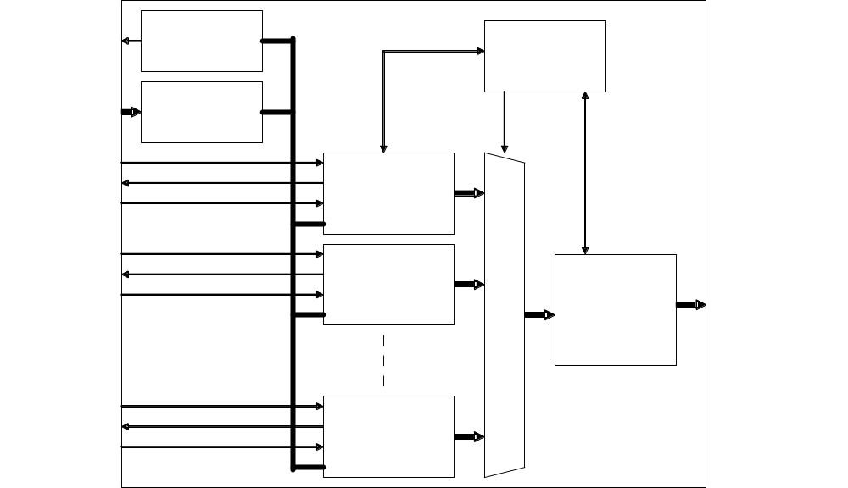
Structure of the DMA Controller Core

Slide 17
Basic DMA operation
The direct memory access (DMA) I/O technique provides direct access to the memory while the microprocessor is temporary disabled.
A DMA controller borrows the address bus, data bus, and control bus from the microprocessor on temporary basis and transfers the data bytes directly between an I/O port and a series of memory locations.

Slide 18
Basic DMA operation (cont..)
Two control signals are used to request and acknowledge a DMA transfer in the microprocessor-based system.
The HOLD signal is a bus request signal which asks the microprocessor to release control of the buses after the current bus cycle.
The HLDA signal is a bus grant signal which indicates that the microprocessor has indeed released control of its buses by placing the buses at their high-impedance states.
The HOLD input has a higher priority than the INTR or NMI interrupt inputs.

Slide 19
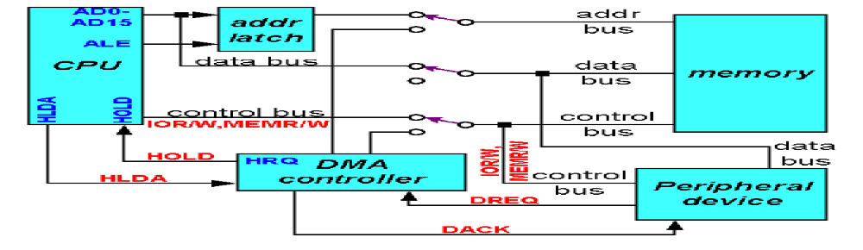
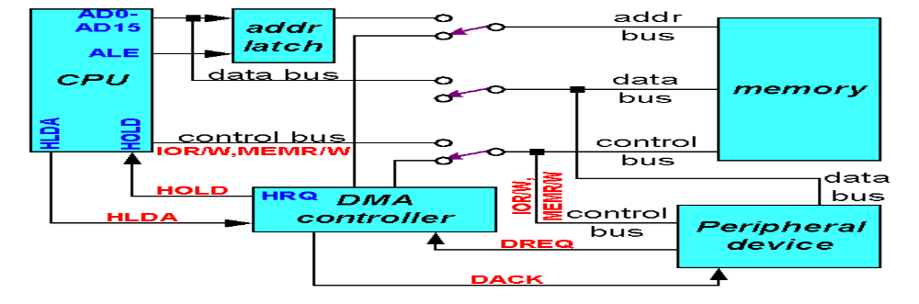
When DMA does not operate
When DMA operates

Slide 20
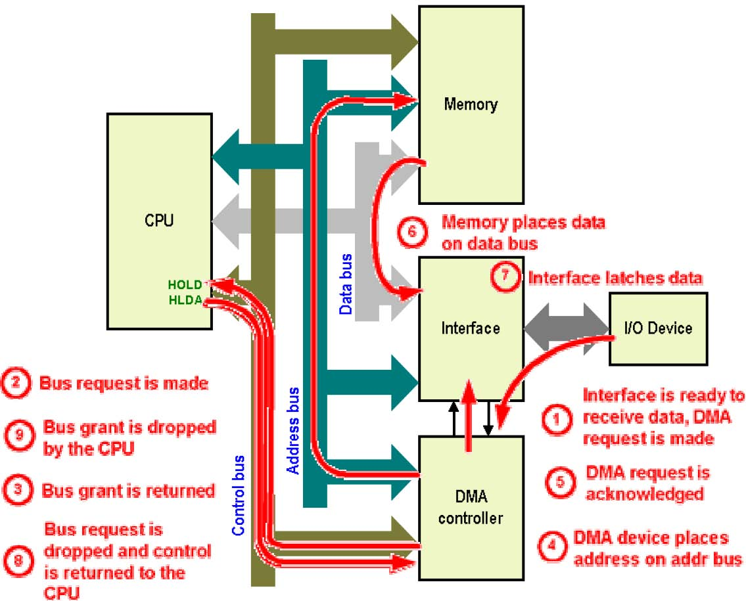
Example: Memory- to- Device transfer

Slide 21
Flow of control signals
8086 8237 device
← DREQ
← HREQ
HLDA →
Use AEN to take
the control of the
buses
DACK →
Provide address plus
MEMW/IOR or
MEMR/IOW
•
← EOP
HREQ ↓
AEN ↓

Slide 22
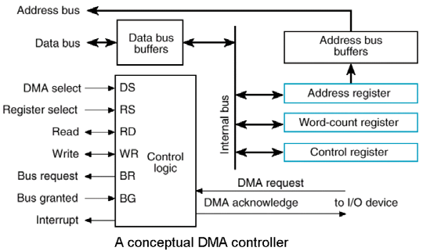
2. The 8237 DMA controller
The 8237 DMA controller supplies the memory and I/O with control signals and memory address information during the DMA transfer.
The 8237 is a four- channel device that is compatible to the 8086/8088 microprocessors and can be expanded to include any number of DMA channel inputs.
The 8237 is capable of DMA transfers at rates of up to 1.6M bytes per second.
Each channel is capable of addressing a full 64K-byte section of memory and can transfer up to 64K bytes with a single programming.

Slide 23
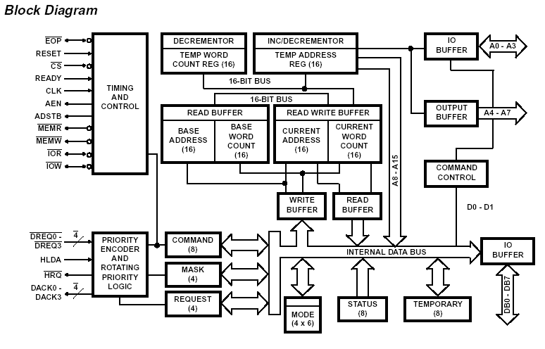

Slide 24
Register Organization of 8237
Current Address Register:- Each of the four DMA channels of 8237 has a 16-bit current address register that hold the current memory address, being accessed during the DMA transfer. The address is automatically incremented or decremented after each transfer and the resulting address value is again stored in the current address register. This may be reinitialized by an auto-initialization command to its original value after EOP.

Slide 25
Register Organization of 8237
2. Current Word Register:- Each channel has 16-bit current word register that hold the number of (counts) data bytes transfers to be carried out. The word count is decremented after each transfer and the new value is again stored back to the CWR. When the count become zero, an EOP signal will be generated. This can be set with the programming by CPU.

Slide 26
Registers Organization of 8237
3. Base Address and Base Word Count Register:- Each channel has a pair of these registers. These maintain the original copy of the respective initial current address register and current word register( before incrementing and decrementing) respectively. The are automatically written along with the current registers. These can’t be read by the CPU. The contents of these registers are used internally for auto-initialization.
Each channel has its own CAR, CWCR, BA and BWC.

Slide 27
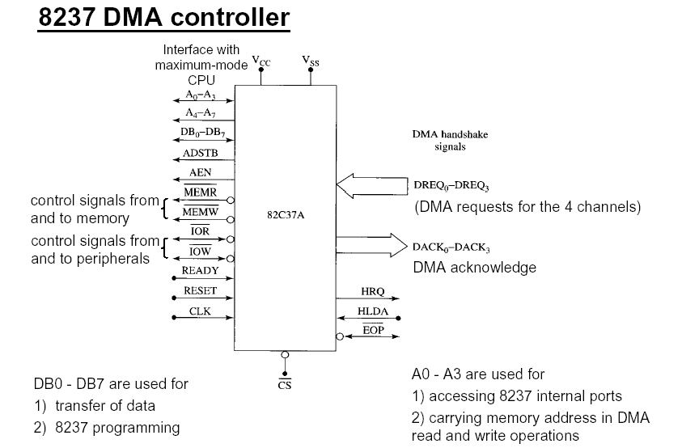

Slide 28
Some important signal pins:
CS (Chip select): enables the 8237 for programming.
RESET (The reset pin): Clears the command ,status ,request ,and temporary registers.
READY (Ready input): Causes the 8237 to enter wait states for slower memory and/or I/O components.
DREQi (DMA request): Used to request a DMA transfer for a particular DMA channel.
DACKi (DMA channel acknowledge): Acknowledges a channel DMA request from a device.

Slide 29
Some important signal pins (Cont..)
HRQ (Hold request): Requests a DMA transfer.
HLDA (Hold acknowledge) Signals the 8237 that the microprocessor has withdraw the control of the address, data and control buses.
AEN (Address enable): Enables the DMA address latch connected to the DB7-DB0 pins on the 8237 and disable any buffers in the system connected to the microprocessor. (Use to take the control of the address bus from the microprocessor).
ADSTB (Address strobe): Functions as ALE to latch address during the DMA transfer (A15-A8).
EOP (End of process): Signals the end of the DMA process.

Slide 30
Some important signal pins (Cont..)
IOR (I/O read): Used as an input strobe to read data from the 8237 during programming and used as an output strobe to read data from the port during a DMA write cycle.
IOW (I/O write): Used as an input strobe to write data to the 8237 during programming and used as an output strobe to write data to the port during a DMA read cycle.
MEMW (Memory write): Used as an output to cause memory to write data during a DMA write cycle.
MEMR (Memory read): Used as an output to cause memory to read data during a DMA read cycle.
A3-A0 (Address pins): Select an internal register during programming.

Slide 31
Internal registers
The command register (CR) programs the operation of the 8237 DMA controller. This can be programmed by CPU and cleared by the reset operation.

Slide 32
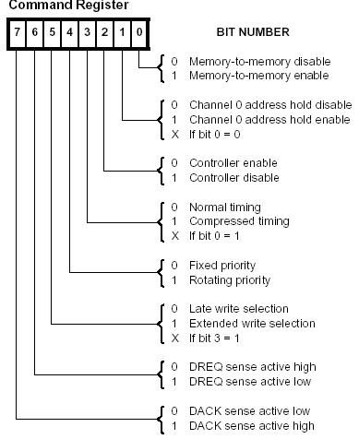
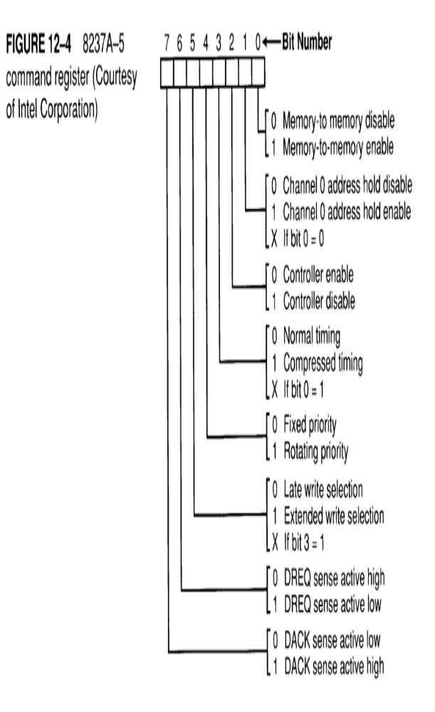
Bit 0
1 -Memory to memory DMA transfer mode enabled.
Bit 1 and Bit 0
11 -Channel 0 hold source address.
-Channel 1 hold destination address.
-Number of bytes transferred stored in channel 1 count register.
Bit 2
0 -Turn the entire controller on.
1- Turn the controller off.
Bit 3 and Bit 0
01 -DMA cycle contains 4 (Normal) clocking period.
11 -DMA cycle contains 2 (Compressed) clocking period.
Bit 4
0 -Channel 0 has highest priority, channel 3 has lowest priority.
1 -The most recently services channel has lowest priority.
Bit 5 and Bit 3
11 -Extend the write pulse for I/O that require wider write pulse.
Bit 6 and bit 7
-Program the polarities of DERQ inputs and DACK outputs.

Slide 33
Internal registers
The mode register (MR) programs the mode of operation for a channel. It is 8-bit register. The can be written by the CPU in program mode.

Slide 34
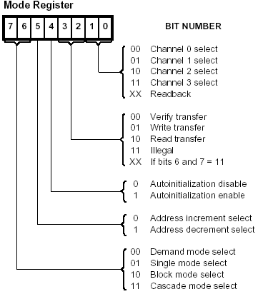
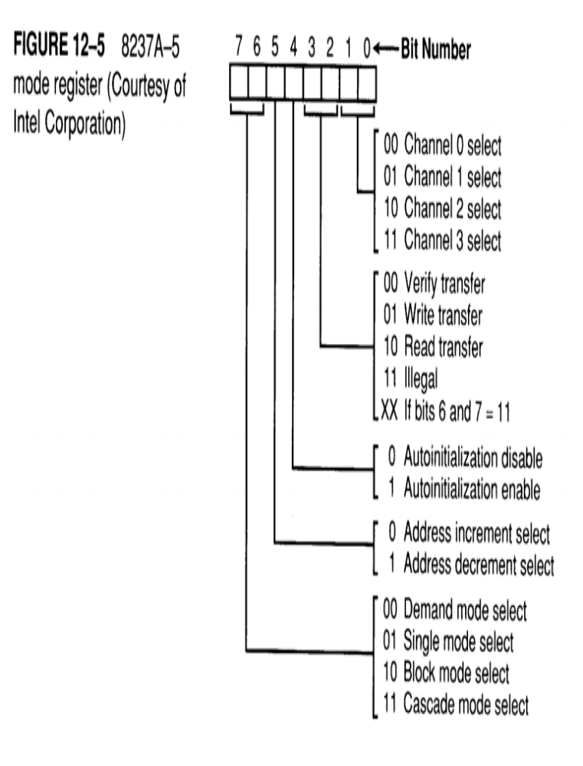
Each channel has its own mode register
Bit 0 and Bit 1
-Select the channel.
Bit 2 and Bit 3
-Select the operation ( Bit 6 and Bit 7 <> 11 )..
Bit 4
-Auto initialization select.
Bit 5
-Address increment/decrement select.
Bit 6 and Bit 7
00 -Transfers data until an external EOP is input or until the DREQ
.
01 -Release the HOLD after each byte of data is transferred.
10 -Automatically transfers the number of bytes stored in the count register.
11 –Used when more than one 8237 is present in the system.

Slide 35
Internal registers
The request register (RR) is used to request a DMA transfer via software, which is very useful in memory-to-memory transfers. Each bit is set and reset under program control or is cleared upon generation of an external EOP.
The mask register set/reset (MRSR) sets or clears the channel mask to disable or enable particular DMA channels.
The mask register (MSR) clears or sets all of the masks with one command instead of individual channels as with the MRSR

Slide 36
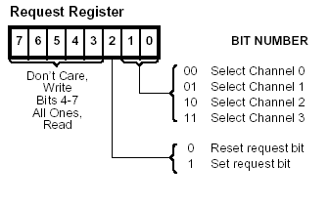
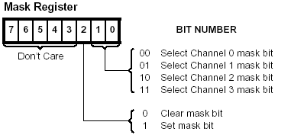
The request register ( RR ) :
-Request DMA via software.
-Memory to memory transfer ( external signal is not available ).
The mask register set/reset ( MRSR ) :
-If the mask is set, the channel is disabled.
-Reset signal sets all channel masks to disable them.
The mask register ( MSR ) :
-Clears or sets all of the masks of all channels with one command.
The status register ( SR ) :
-Shows the status of each DMA channel.
-TC bits indicates whether the channel transferred all its bytes.
-Request bits indicates whether the DREQ input is active.

Slide 37
Internal registers
The status register (SR) shows the status of each DMA channel pending requests and the status of their terminal count (TC). The bits D₀-D₃ are updated every time, the corresponding channel reaches TC or an external EOP occurs. These are cleared by reset operation. Bits D₄-D₇ are set, if the corresponding channels request services.

Slide 38
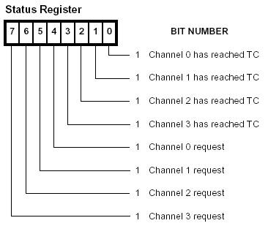

Slide 39
Internal registers
Temporary Registers:- The temporary registers holds data during memory-to-memory data transfers. After the completion of the transfer operation, the last word transferred remains in the temporary register till it is cleared by a reset operation.

Slide 40
Software commands
There are 3 software commands used to control the operation of the 8237.
  Clear the first/last (F/L) flip-flop.
    F/L = 0 ( Low order byte of CAR and CWCR is read/written ).
    F/L = 1 ( High order byte of CAR and CWCR is read/written ).
  Master clear - Disable all DMA channels ( as with the reset signal ).
  Clear mask register - Enables all DMA channels.
The command is issued by writing a dummy byte to the corresponding port.

Slide 41
Programming the 8237
There are 4 steps required to program the address and count registers first:
  Clear the F/L flip-flop with a clear F/L command.
  Disable the channel.
  Program the LSB and then MSB of the address.
  Program the LSB and then MSB of the count
Additional programming is required to select the mode of operation before the channel is enabled and started.

Slide 42
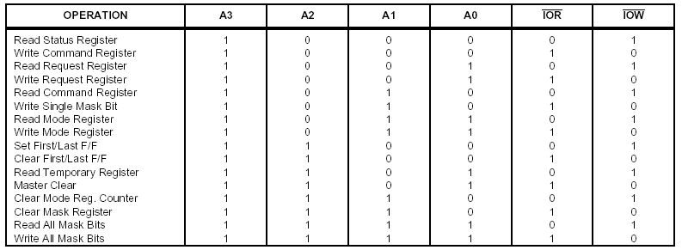

Slide 43
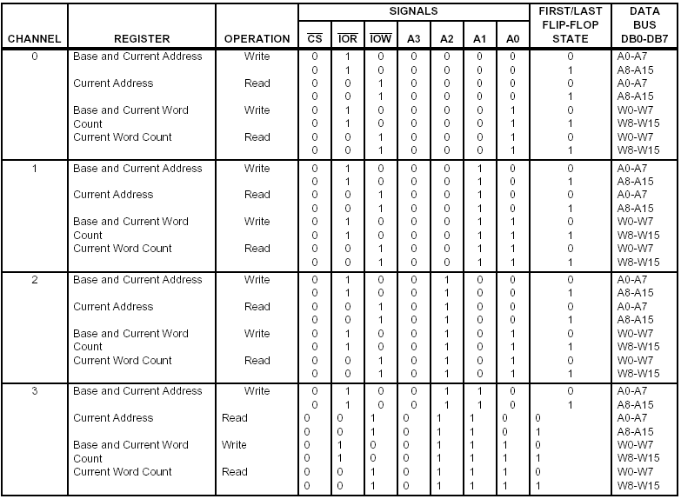

Slide 44
How an 8237 works in an 80X86-based system
During normal 80x86 operation :the DMA controller and integrated circuits B and D are disabled.
During a DMA action :
AEN (enable B & D and disable IC, A, C & E).
(A7-A0) are provided by 8237.
ADSTB clocks (A15-A8) into latch D.
(A19-A16) are provided by latch B.
Decoder F select 8237 and latch B.
the 8237 can take control of the system through the address, control and data buses.

Slide 45
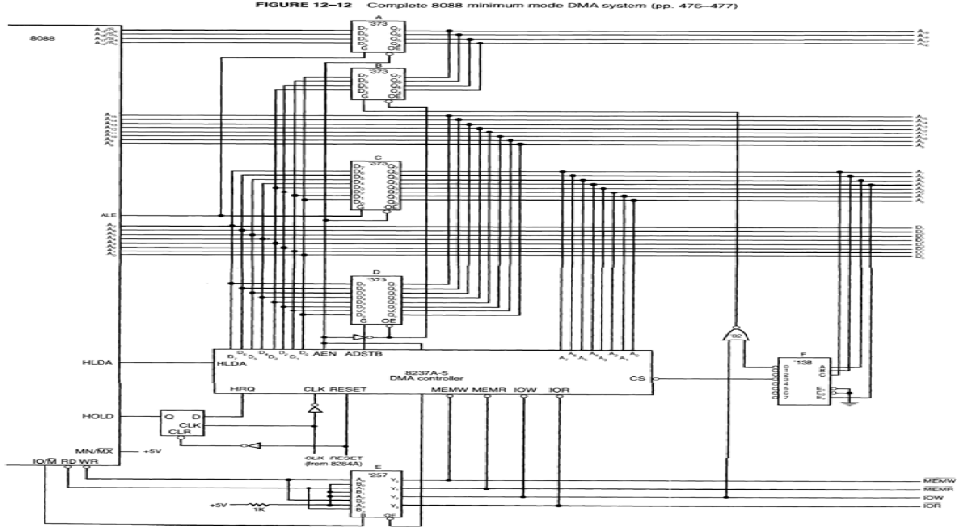

Slide 46
Memory-to-memory transfer with the 8237 :-
MOVSB requires 4.2 µs per byte ( 8088 ).
8237 DMA requires 2.0 µs per byte ( 8088 ).
Sample memory-to-memory DMA transfer :
Suppose the contents of memory locations 10000H-13FFFH are to be transferred into memory locations 14000H-17FFFH.
Leftmost digit is sent to latch B.
clear F/L flip-flop.
use channel 0 as the source.
use channel 1 as the destination.
The number of bytes transferred is loaded into channel 1 count.
Program mode register of each channel.
Command register selects a block move.
Channel 0 is enabled.
DMA request is initiated.
Status register is tested for terminal count (TC).
TC disables the channel, preventing additional transfers.

Slide 47
